Slide 1
A Comparison of Graph-Based Synthetic Data Generators for Benchmarking Next-Generation Intrusion Detection Systems
By: Jordan Donovan

Slide 2
Motivation
Inadequate intrusion detection systems
Graphs can offer benefits
Need to measure performance of processing tools
Notes:
Inadequate IDS
Unable to detect coordinated attacks
High false positive rate
Graphs can offer benfits:
Model network traffic, attacker behavior, or defended system leads to better understanding
Leverage graph processing platforms to identify malicious traffic patterns
These graphs can reach sizes that make them difficult to analyze
Need to measure performance of big data processing tools:
Graphs have begun to be adopted for the purpose of intrusion detection, but benchmarks have not been set yet.
Extreme importance in knowing how efficient these algorithms could be applied to cyber security problem
Difficult to make decision based because of the lack of knowledge in how these tools will operate in cyber security setting

Slide 3
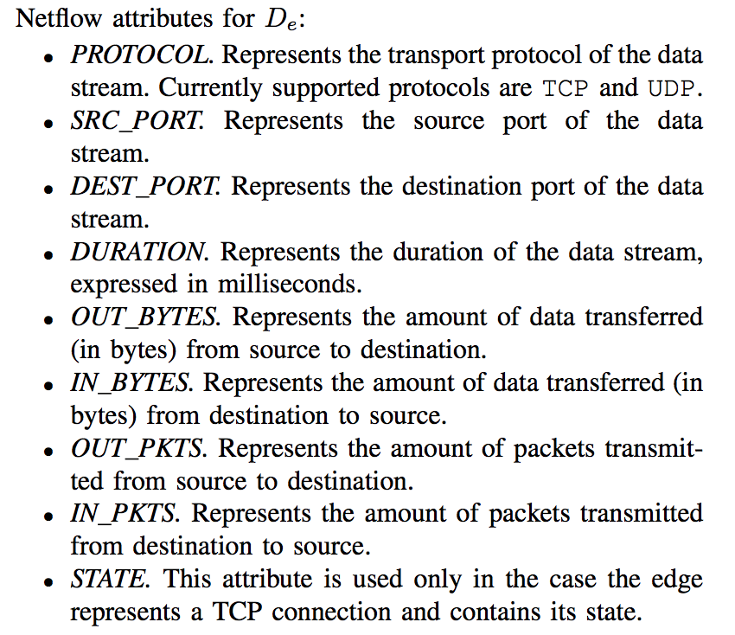
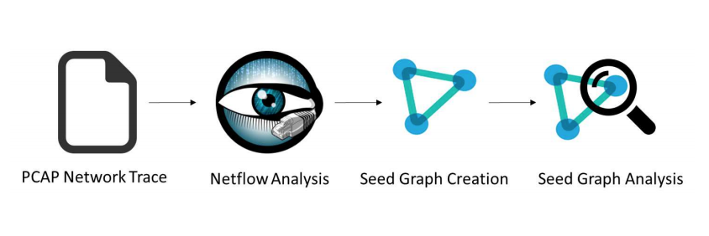
Contribution
Synthetic data generation and graph generation
Extensive evaluation of models
Source code
Notes:
Synthetic Data Generation:
Lack of openly available data sources due to privacy concerns
Able to capture all of the aspects of a network trace
Graph generation models based on Barbasi-Albert and Kronecker algorithms. These will support property-graphs for netflow data representation. Grow an existing seed graph
Barbasi-Albert:
Is iterative. Each iteration has two steps; growth and preferential attachment
In this paper, the generative algorithm keeps constant the amount of newly added vertices and the amount of edges in the graph
Kronecker:
Stochastic Kroenecker: 2 steps
Gereration of the initiator matrix
Generation of synthetic data by creating edges
Variant of stochastic kroenecker which adds to its features to support property-graphs
Extensive Evaluation of Models:
Show the synthetically generated data exhibits high veracity
Show that this approach is able to generate big data in a timely manner (hour time-frame) when distributing the load on 60 compute nodes
Show linear scalability of proposed algorithms and execution platform scales linearly with the number of computer nodes used for generation

Slide 4
Proposal
Graph-based synthetic data generators are valid for intrusion detection
Comparison of performances for benchmarking
Notes:
Graph-Based synthetic data generators are valid for intrusion detection
Synthetic dataset is representative of real data that has been used as a seed
The generation of the graph was timely
Is flexible and scalable to cyber security needs
Comparsion of Performance for benchmarking
These algorithms will do well and set a benchmark for future graph-based synthetic generation for intrusion detection systems
We will be able to see how these two algorithms compare to one another setting the precedent for more algorithms comparisions

Slide 5
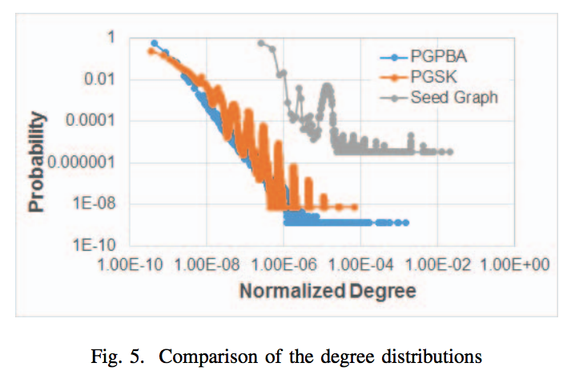
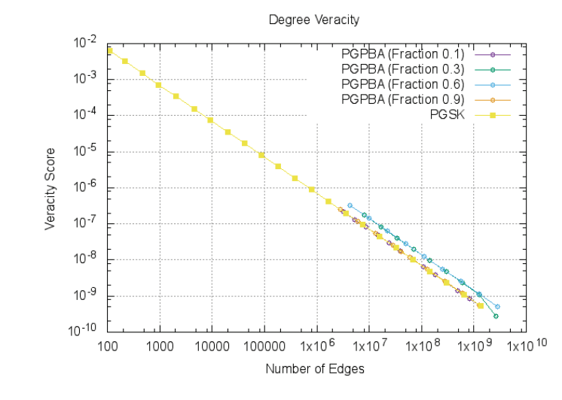
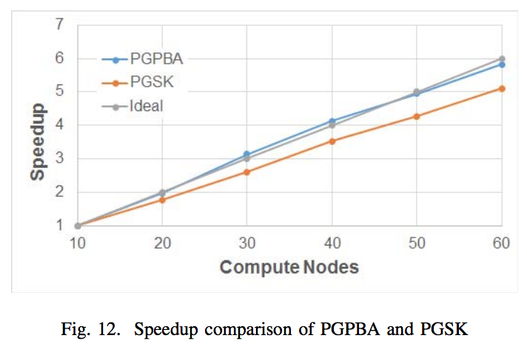
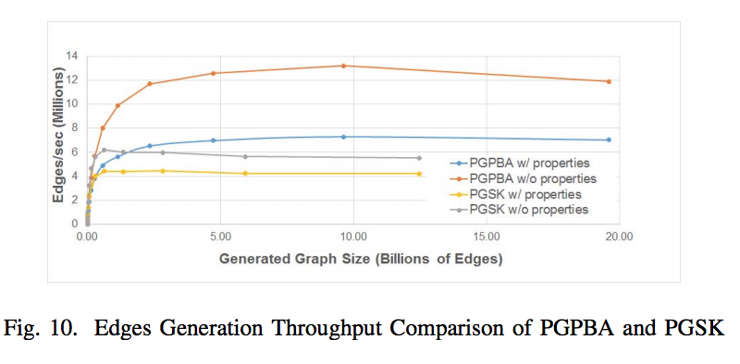
Results
Veracity
Performance
Notes:
Veracity:
Property-Graph Parallel Barbasi-Albert and Property-Graph Stochastic Kroenecker both scale linearly according to the size of the synthetic graph and the number of compute nodes.
Comparison of degree distribution shows that the synthetically generated graphs mimic the seed graph closely (Not overlapping due to normalization)
All five experiments on right graph show a linear veracity that decreases as the size of the graph grows. (Reflects the seed graph better as more data is generated). (PageRank veracity is very similar to Degree Veracity graph)
Performance:
Scalability is shown for both platform and graphs
For graphs constant computational resources and varied graph size was used
For platforms constant graph size and varied computational resources were used.
12 Cores allowed maximum throughput for both algorithms
PGP Barbasi-Albert creates edges much quicker than PG Stochastic Kroenecker
Graphs of fixed sized with increased compute nodes show scalability. Speedup is linear with respect to compute nodes.
BA performs better here being very close to ideal

